Slide 1

Electronic Devices and Circuits

Slide 2
Syllabus
CSE 223: Electronics Device and Circuits
Introduction to semiconductors, p-type and n-type semiconductors; p-n junction diode characteristics; Diode applications: half and full wave rectifiers, clipping and clamping circuits, regulated power supply using zener diode.
Bipolar Junction Transistor (BJT): principle of operation, I-V characteristics; Transistor circuit configurations (CE, CB, CC), BJT biasing, load lines; BJTs at low frequencies; Hybrid model, h parameters, simplified hybrid model; Small-signal analysis of single and multi-stage amplifiers, frequency response of BJT amplifier.
Field Effect Transistors (FET): principle of operation of JFET and MOSFET; Depletion and enhancement type NMOS and PMOS; biasing of FETs; Low and high frequency models of FETs, Switching circuits using FETs; Introduction to CMOS.
Operational Amplifiers (OPAMP): linear applications of OPAMPs, gain, input and output impedances, active filters, frequency response and noise.
Introduction to feedback, Oscillators, Silicon Controlled Rectifiers (SCR), TRIAC, DIAC and UJT: characteristics and applications; Introduction to IC fabrication processes.

Slide 3
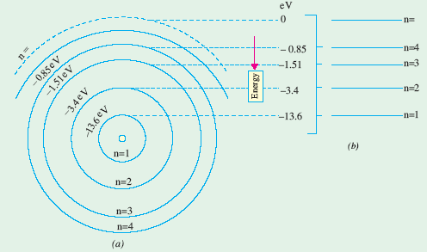
Electron Energy Levels in Hydrogen Atom
Orbital energy of an electron revolving in nth orbit or shell:
For hydrogen atom, Z = 1, then
Figure: Energy levels for hydrogen atom (Z = 1).

Slide 4
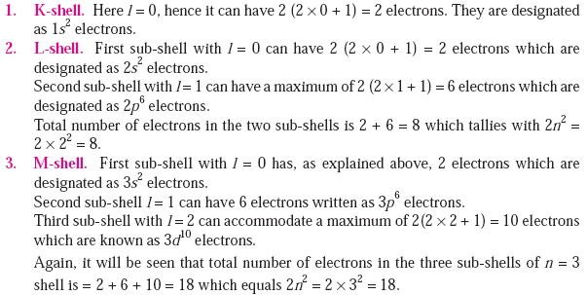
Electron Distribution in an Atom
In an atom, all orbits (except n = 1 orbit) consist of more than one orbit called sub-orbits.
The group of sub-orbits is collectively known as shell.
Each sub-orbit (sub-shell) in a shell is designated by a number l (0, 1, …, n−1) called the orbital quantum number.
The maximum number of electrons which a sub-shell of any n-value can accommodate is 2(2l + 1).
The maximum number of electrons a shell can have is 2n².

Slide 5
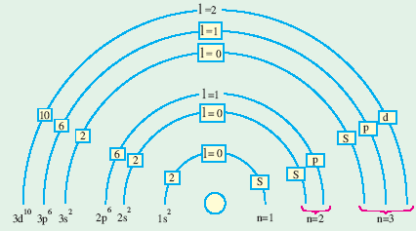
Maximum no. of electrons = 2(2l + 1)
K-shell
L-shell
M-shell

Slide 6
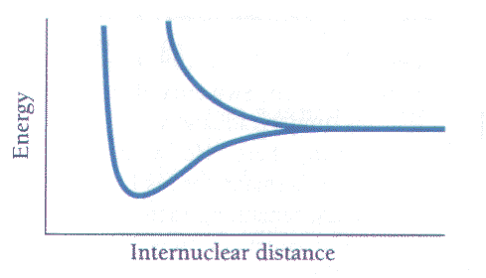
Energy Bands in Solids
In the case of an isolated single atom, there is single energy level per orbit.
There are significant changes in the energy levels when atoms are brought together as in solids.
The energy levels of an atom splits into N levels of energy where N is the number of atoms in the crystal.
Each original energy level becomes a band of very closely-spaced levels of slightly different energy.
Since only two electrons of opposite spin can occupy the same state, so there are 2N possible quantum states in each band.
Let’s consider sodium as an example. Sodium has a single outer 3s electron:
When two sodium atoms are brought together, the 3s energy level splits into two separate energy levels.
Things to note: 4 quantum states but only 2 electrons.

Slide 7
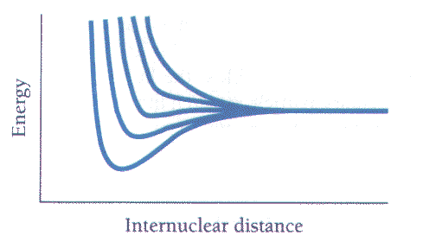
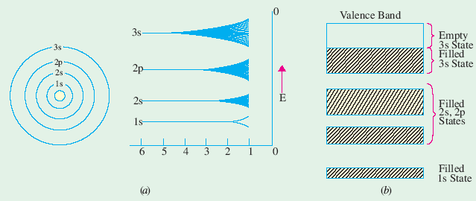
When five sodium atoms are brought together, the 3s energy level splits into five separate energy levels.

Slide 8
Valence and Conduction Bands
The electrons in the outermost shell are called valence electrons and have the highest energy, i.e., least binding energy.
The band of energy occupied by the valence electrons is called valence band. It may be completely or partially filled with electrons but never empty.
The next higher permitted energy band is called the conduction band and may either be empty or partially filled with electrons.
In conduction band, electrons can move freely and hence are known as conduction electrons.
The gap between valance and conduction bands is known as forbidden energy gap.
If a valance electron absorbs enough energy, it jumps across the forbidden energy gap and enters the conduction band.
Conduction electrons are found in and freely flow in the conduction band.
When an electron is ejected from the valance band, a covalent bond is broken and a positively charged hole is left behind.
Holes exist in and flow in the valence band.
Conduction electrons move almost twice as fast as the holes.

Slide 9
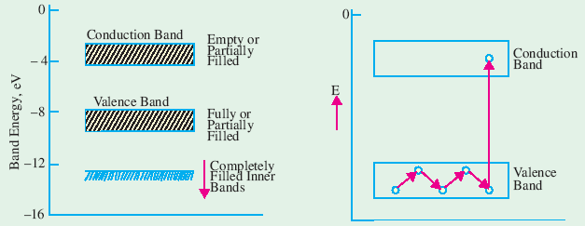

Slide 10
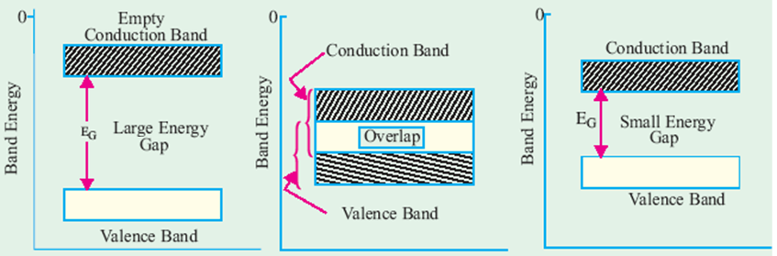
(a) Insulator
(b) Conductor
(c) Semiconductor

Slide 11
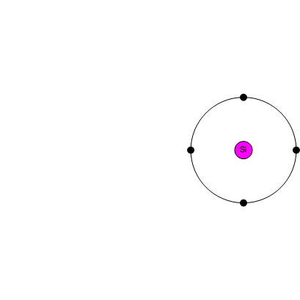
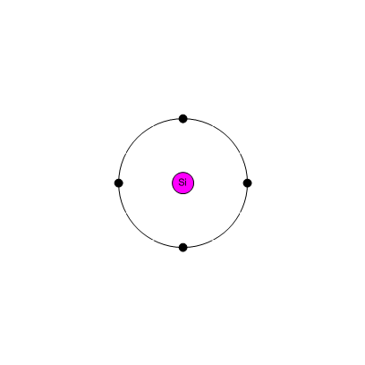
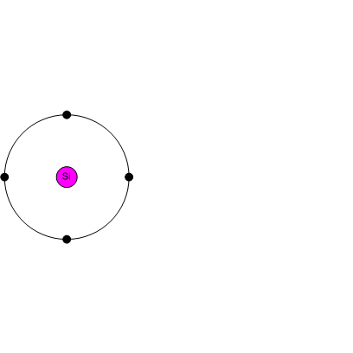
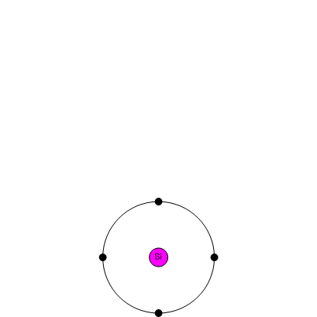
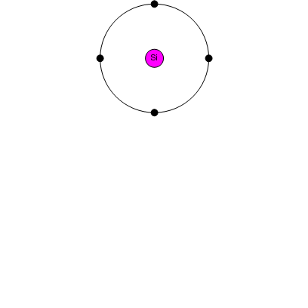
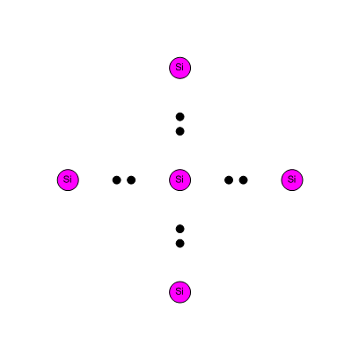
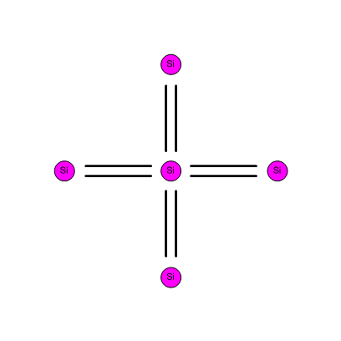
Covalent Bonds
Silicon has a valence of 4 i.e. 4 electrons in its outer shell.
Each silicon atom shares its 4 outer electrons with 4 neighbouring atoms and forms covalent bonds.

Slide 12
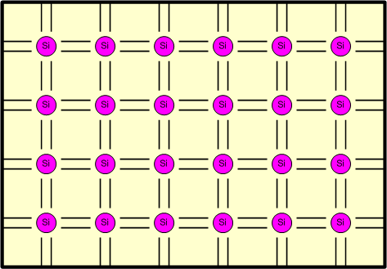
Crystal Lattice of Silicon
It has no free electrons – it cannot conduct electricity – therefore it behaves like an insulator.

Slide 13
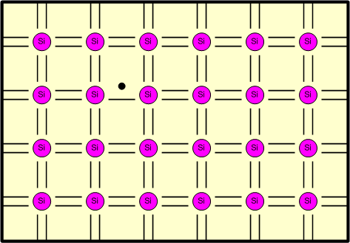
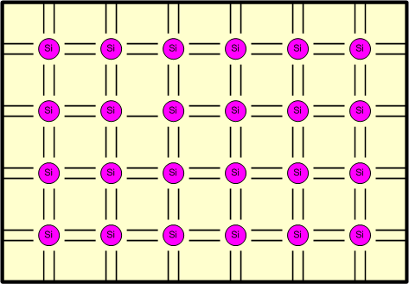
An electron may gain enough energy to break its bond…
It is then available for conduction and is free to travel throughout the material

Slide 14
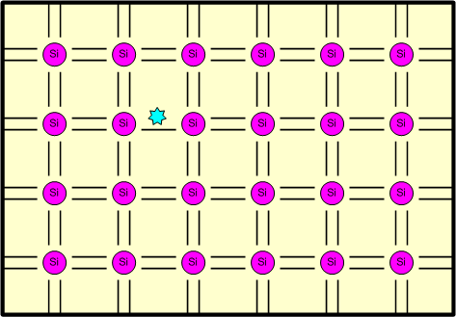
As the electron left there is a gap in the bond – what we call a hole.

Slide 15
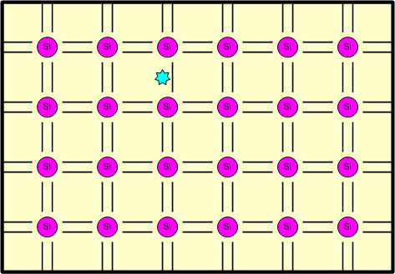
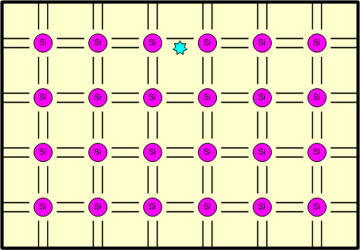
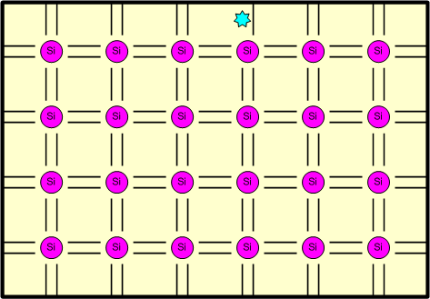
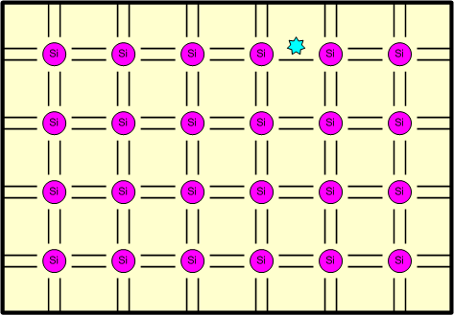
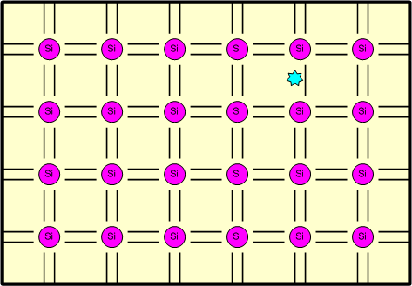
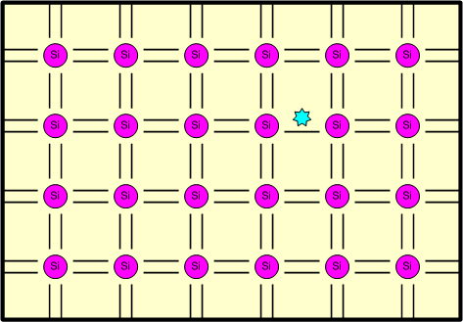
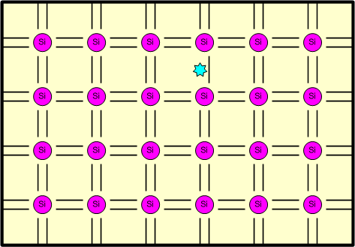
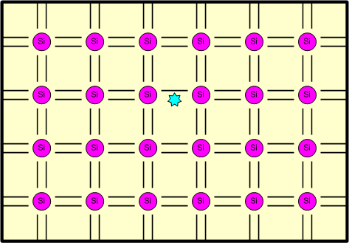
This hole can also move…
An electron – in a nearby bond – may jump into this hole…
Effectively causing the hole to move…
Like this…

Slide 16
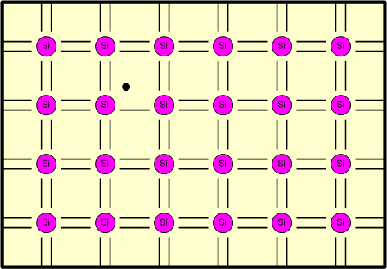
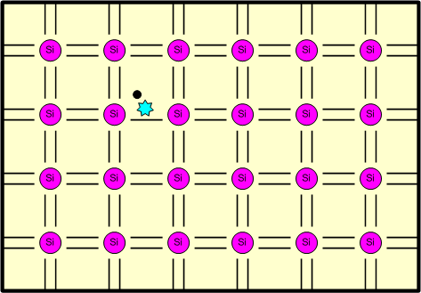
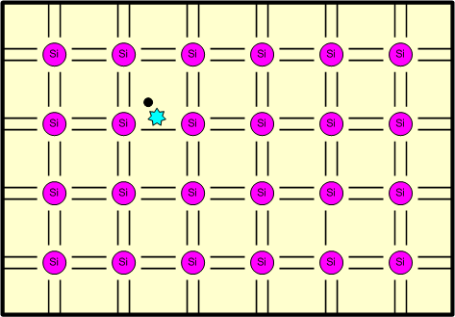
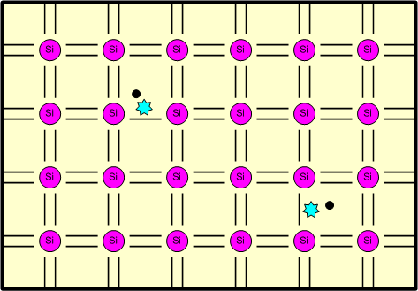
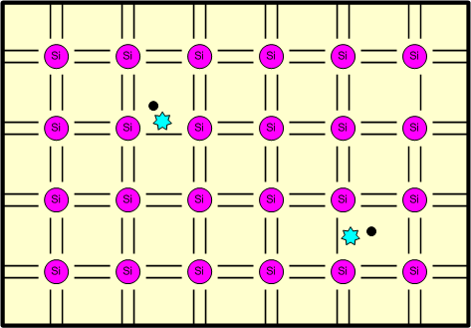
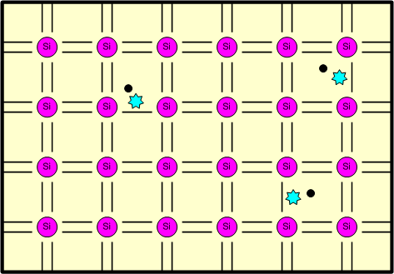
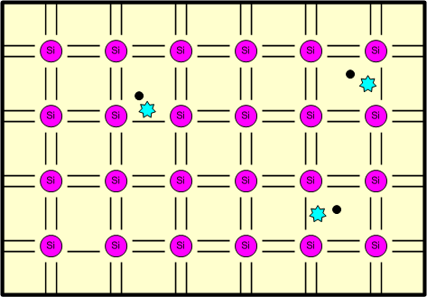
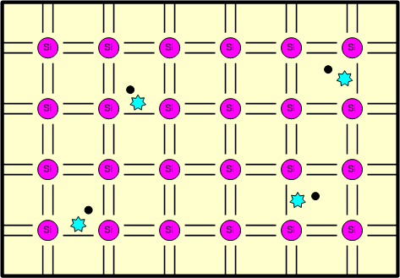
We have seen that, in silicon, heat releases electrons from their bonds…
This creates electron-hole pairs which are then available for conduction

Slide 17
Categories of Solids
There are three categories of solids, based on their conducting properties:
Conductors
have an overlapping valence and conduction band
plenty of free electrons are available for conduction
Semiconductors
almost an empty conduction band
almost a filled valence band
a very narrow energy gap (of the order of 1 eV) between them
Insulators
have a full valence band
have an empty conduction band
have a large energy gap (of several eV) between them

Slide 18
Semiconductors
Types of Semiconductors
Intrinsic or pure semiconductors
Example: Silicon (Si) – Forbidden energy gap is 1.1 eV
Germanium (Ge) – Forbidden energy gap is 0.72 eV
Extrinsic semiconductors
P-type
N-type
L
N
Conductivity of a Semiconductor
A
Current density,
where
n = electron concentration (per m³)
p = hole concentration (per m³)
μ_{n} = mobility of the electrons (m²/V-S)
μ_{p} = mobility of the holes (m²/V-S)
σ = conductivity in (Ω-m)⁻¹
For intrinsic semiconductor, n = p = n_{i}
Electron concentration
Drift velocity

Slide 19
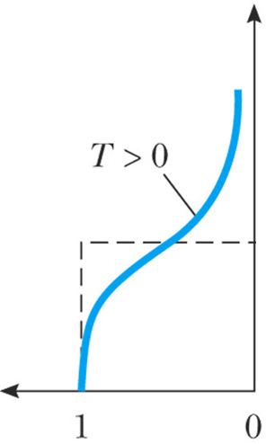
Carrier Concentration in an Intrinsic Semiconductor
To calculate the conductivity of a semiconductor it is necessary to know:
The concentration of free electrons n in conduction band and
The concentration of holes p in valence band
For calculating n, the following two factors should be considered:
How many energy levels are there in the conduction band within a given range and
How likely each level will be populated by an electron
The likelihood in the second factor is given by a probability function called the Fermi-Dirac distribution function f(E) at energy E,
where
k = Boltzmann constant in eV/⁰K
T = Temperature in ⁰K
E_{F} = Fermi level in eV
The Fermi level represents the energy state with 50% probability of being filled if no forbidden band exists.

Slide 20
Now, the no. of conduction electrons/m³ whose energies lie between E and E+dE is given by
where N(E) is the density of states and is given by
is a constant = 6.82×10²⁷ [m⁻³(eV)^{-3/2}]
If in a semiconductor the lowest energy in the conduction band is E_{C}, then
For E ≥ E_{C}, E − E_{F} >> kT, then Eq. (1) reduces to
and
where

Slide 21
The no. of holes in the valence band:
Since the top of the valence band is E_{V}, the density of states as in Eq. (4) is given by
The Fermi function for a hole is 1−f(E), then we have
where we have assumed that E_{F} − E>> kT, E_{V} ≤ E. Hence the no. of holes per cubic meter in the valence band is
where N_{V} is given by Eq. (7) with m_{n} replaced by m_{p}.
The Fermi level in an intrinsic semiconductor:
For intrinsic semiconductor, n = p = n_{i}, (11)
If m_{n} = m_{p}, then N_{C}=N_{V}=N, (13) and
Hence the Fermi level lies in the centre of the forbidden energy band.

Slide 22
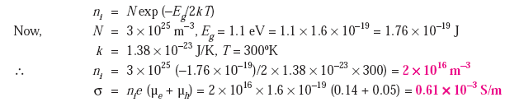
The intrinsic carrier concentration:
where E_{G} = Energy gap between valence and conduction band = E_{C}−E_{V}
Using Eq. (11) and (13), Eq. (15) reduces to
Problem:

Slide 23

Extrinsic Semiconductor
Extrinsic semiconductor = Intrinsic semiconductor + Impurity/doping agent/dopant

Slide 24
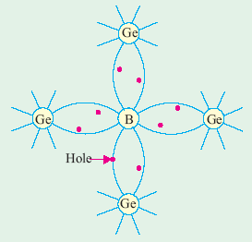
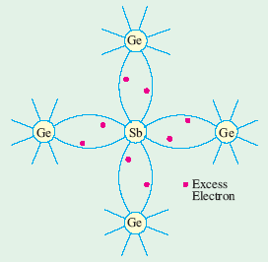
P-type semiconductor
N-type semiconductor
Conduction band
Conduction band
Energy
Energy
E_{G}
E_{G}
Valence band
Valence band
(a)
(b)
Position of Fermi level in (a) P-type and (b) N-type semiconductors

Slide 25
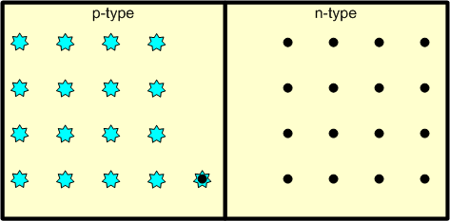
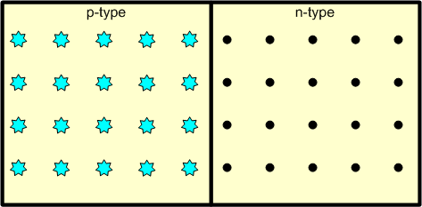
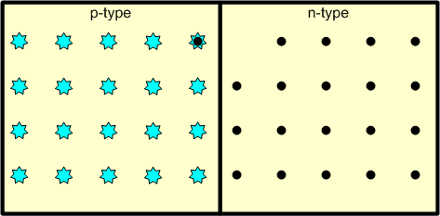
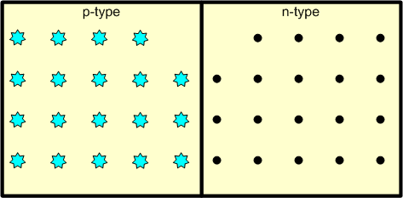
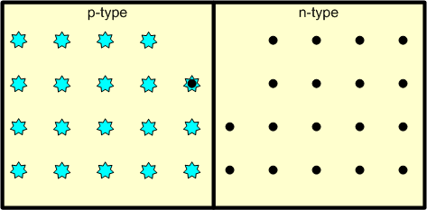
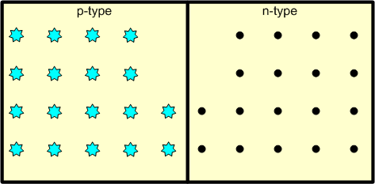
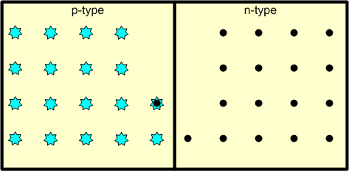
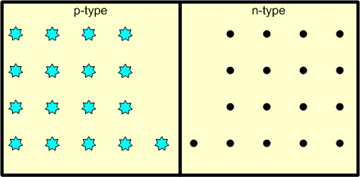
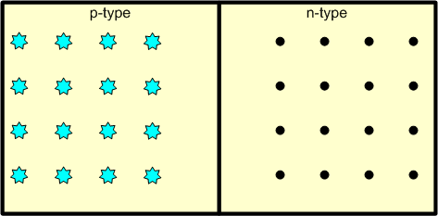

The P-N Junction
If donor impurities are introduced into one side and acceptors into the other side of a single crystal of a semiconductor a p-n junction is formed.
Since there is a density gradient across the junction, holes will diffuse to the right across the junction and electrons to the left.
As a result of the displacement of these charges, an electric field will appear across the junction.
Equilibrium will be established when the field becomes large enough to restrain the process of diffusion.
The region of the junction is called the depletion region or depletion layer.
+
−
Charge density
−
+
−
+
−
+
−
+

Slide 26
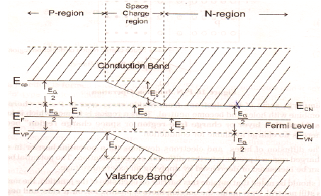
Band Structure of an Open Circuited P-N Junction

Slide 27

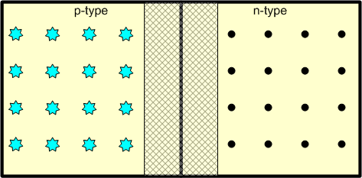

P-N Junction as a Diode
Reverse Bias:

Slide 28

Forward Bias:

Slide 29


Forward Bias:

Slide 30

Forward Bias:

Slide 31


Slide 32

I-V characteristics of a PN junction diode:

Slide 33

Applications of Diode

Slide 34
Rectifiers
Rectifier is a device which convert AC voltage in to pulsating DC.
A rectifier utilizes unidirectional conducting device, such as P-N junction diodes.
Types of Rectifiers
Half-wave rectifier
Full-wave rectifier

Slide 35


Half-Wave Rectifier Circuit
Full-Wave Rectifier Circuit

Slide 36


Bridge Rectifier Circuit

Slide 37
Ripple Factor:
Instantaneous ac component of current,
Combining Eq. (1) and (3), we get

Slide 38
For half-wave rectifier,
For half-wave rectifier,

Slide 39


Half-Wave Rectifier Circuit with Capacitor Filter

Slide 40
Bridge Rectifier with Capacitor Filter

Slide 41

Clipping Circuits
Clippers circuits are used to remove the part of a signal that is above or below some defined reference level.

Slide 42



Slide 43


Clamping Circuits
Clamping circuits introduce a dc level into an ac signal.

Slide 44


Zener Diode

Slide 45



Slide 46




Bipolar Junction Transistor (BJT)
A junction transistor consists of silicon (or germanium) crystal in which a layer of n-type silicon is sandwiched between two layers of p-type silicon, and the transistor is referred to as a p-n-p transistor.
PNP Transistor
Symbol of PNP Transistor
Symbol of NPN Transistor
NPN Transistor
Alternatively, a transistor may consist of a layer of p-type between two layers of n-type material.

Slide 47


Emitter (E)
It is more heavily doped than any of the other regions because its main function is to supply majority charge carries (either electrons or holes) to the base.
Base (B)
It forms the middle section of the transistor. It is very thin (10–6 m) as compared to either the emitter or collector and is very lightly-doped.
Collector (C)
Its main function (as indicated by its name) is to collect majority charge carriers coming from the emitter and passing through the base. Collector region is made physically larger than the emitter region because it has to dissipate much greater power.

Slide 48

Transistor Biasing
emitter-base junction is always forward-biased and
collector-base junction is always reverse-biased

Slide 49

Transistor Configuration
Three types of circuit connections called configurations for operating a transistor:
Common base (CB)
Common emitter (CE)
Common collector (CC)

Slide 50

Transistor Currents
Three primary current of a properly biased transistor:
Base current, I_{B}
Collector current , I_{C}
Emitter current, I_{E}

Slide 51

CE Transistor
Input Characteristics:

Slide 52

Output Characteristics:

Slide 53

Relation between α and β:

Slide 54



Slide 55


From the figure, we get
β

